Slide 1

Water Rights & Ethics: Who Really Owns the Water?
Isabelle Largen, Luke Juran, Erika Bonnett, Erin J. Ling, Leigh-Anne H. Krometis, Madeline, E. Schreiber (Virginia Tech)
Notes:
Instructor is encouraged to use the Guided Inquiry to help deliver the lesson.

Slide 2
Goals
Gain a deeper understanding of issues surrounding water rights, water development, and related water issues.
Act out a fictional scenario related to your local community and environment.

Slide 3
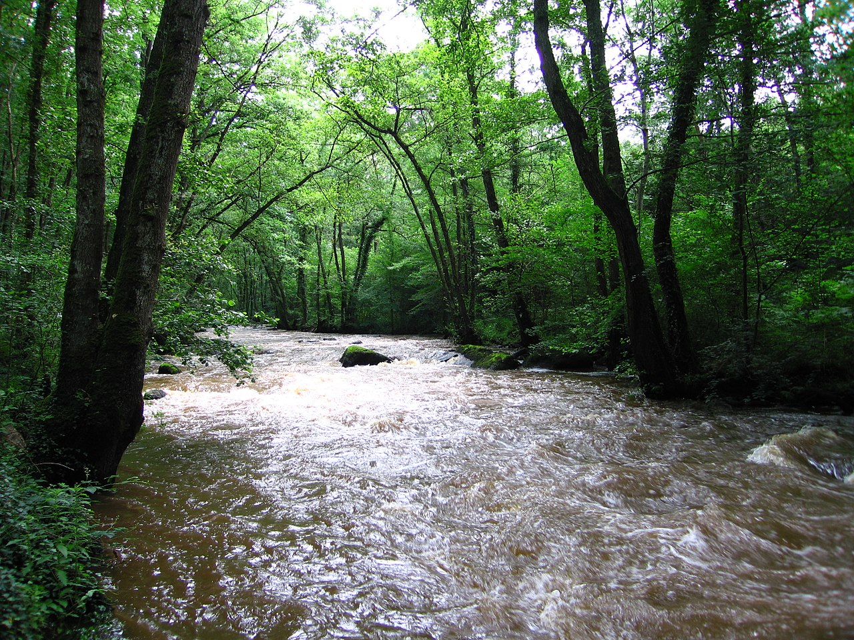
Pre-Activity Questions
Who has the right to water?
Who “owns” the water or the right to develop water resources?
Should there be limits on water use?
Credit: Vincent, 2007.

Slide 4
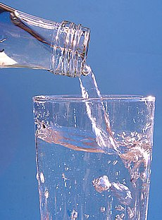
The Scenario
“Tasty Water” bottling company has requested rights to pump water from a municipal well in Anytown, USA. It seeks to pump 400 gallons per minute. Tasty Water will transport water pumped from the municipal well to a factory in the neighboring town to be bottled and sold to the public. Tasty Water believes it should be allowed to purchase water just like the other residents of Anytown.
A public meeting has been called consisting of representatives from four stakeholder groups: (1) Tasty Water, (2) Town Council, (3) a local environmental organization, (4) a group of concerned citizens.
Credit: Pilsak, 2005.

Slide 5
Stakeholder Discussion
Break into four stakeholder groups.
Read your group’s description and discuss the following:
  Should Tasty Water be allowed to pump water from the town’s well?
  How much water should Tasty Water be allowed to pump?
  How much should Tasty Water pay for the water?
  Can Tasty Water’s pumping rights be changed in the future or taken away?

Slide 6

Large Group Discussion
Stakeholder groups share stances.
Openly discuss issues.
Propose policy options and vote on a final resolution.
Credit: Rafizeldi, 2013.

Slide 7
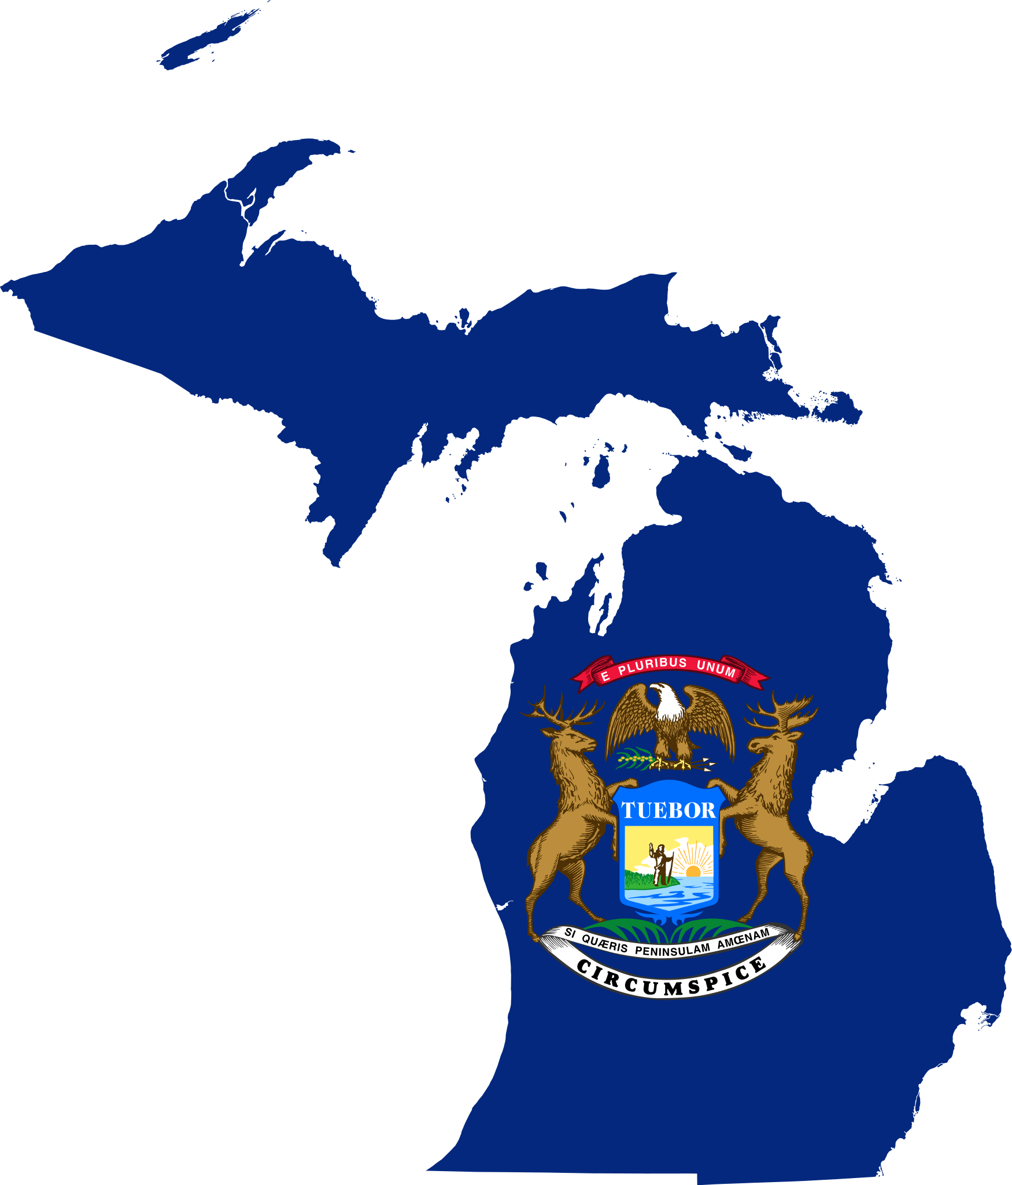
The Actual Scenario: Evart, Michigan
From 2004-2015, Nestle pumped a total of 3.4 billion gallons of water from a municipal well in Evart, Michigan.
The water was transported to a neighboring town for bottling, and only a few new jobs were created in the town and region.
Sources: Ellison, 2021; Taillard, 2018; Winter, 2017.
Credit: Flag map
of Michigan 2012.

Slide 8
The Actual Scenario: Evart, Michigan
Nestle paid a one-time permitting fee of $5,000 and a yearly fee of $200 to pump roughly 576,000 gallons of water per day.
The rate is cheaper than what town residents paid for water:
  Nestle paid 0.000347 cents per gallon.
  A typical rate for citizens was 0.003 cents per gallon (roughly 10 times greater than Nestle’s rate).
  Meanwhile, the bottles of water were sold for greater than 1,000 times the price Nestle paid to purchase the water.
  Sources: Ellison, 2021; Taillard, 2018; Winter, 2017.

Slide 9
The Actual Scenario: Evart, Michigan
In 2018, Nestle was granted a new permit to pump 400 gallons per minute from the municipal well.
The permit was eventually modified after extensive review, public outcry, and sale of the company.
The current permit allows for the extraction of 288 gallons per minute (as a comparison, the average American uses roughly 100 gallons per day).
Sources: Ellison, 2021; Taillard, 2018; Winter, 2017.

Slide 10
The Actual Scenario: Evart, Michigan
How do you feel about the outcome in this real-life situation?
Are there some groups that were not considered or represented?
Do you think scenarios like this might be occurring in other communities throughout the U.S.? How might the issues be different in different locations?

Slide 11

Local Applications
What other industries and activities, besides bottling water, use large quantities of water?
Who are the largest water users in this region?
Given the scenario of Evart, how would you feel if this happened in your town?
Credit: Salazar210 2018.

Slide 12
References
Ellison, G. 2021. “Nestle water owners return Michigan permit, plan new withdrawal.” M Live, October 20, 2021. https://www.mlive.com/public-interest/2021/10/nestle-water-owners-return-michigan-permit-plan-new-withdrawal.html.
Flag map of Michigan. 2012. https://commons.wikimedia.org/wiki/File:Flag_map_of_Michigan.svg, via Wikimedia Commons. Licensed under CC BY-SA 3.0. http://creativecommons.org/licenses/by-sa/3.0/.
Pilsak, W. J. 2005. https://en.wikipedia.org/wiki/Total_dissolved_solids#/media/File:Stilles_Mineralwasser.jpg. Licensed under CC BY-SA 3.0. http://creativecommons.org/licenses/by-sa/3.0/.
Rafizeldi, M. 2013. https://commons.wikimedia.org/wiki/File:Discussion.png. Licensed under CC BY-SA 3.0. https://creativecommons.org/licenses/by-sa/3.0.
Salazar210 at English Wikipedia. 2008. https://commons.wikimedia.org/wiki/File:Blue_question_mark.jpg. CC BY-SA 3.0. https://creativecommons.org/licenses/by-sa/3.0.
Taillard, M. “Opinion: Nestlé water deal is bad economics – and bad policy – for Michigan.” Bridge Michigan. April 3, 2018. https://www.bridgemi.com/guest-commentary/opinion-nestle-water-deal-bad-economics-and-bad-policy-Michigan.
Vincent. 2007. The Rouvre River. Public domain. https://commons.wikimedia.org/wiki/File:La_Rouvre.JPG.
Winter, C. 2017. “Nestlé Makes Billions Bottling Water It Pays Nearly Nothing For.” Bloomberg. September 21, 2017. https://www.bloomberg.com/news/features/2017-09-21/nestl-makes-billions-bottling-water-it-pays-nearly-nothing-for.

